Slide 1

Blood Bank Management
Hajee Mohammad Danesh Science And Technology University, Dinajpur

Slide 2
Course Title: Application Development Sessional
Course Code: CSE-252
Group No: 13
Name of the Advisor
Md. Rashedul Islam
Assistant Professor, Department of CSE, HSTU
Submitted by
Md Rakibul Hasan, Student ID: 1702008
Md Jahidul Islam, Student ID: 1702037
Md Touhid Islam, Student ID: 1702040

Slide 3
Motivations of the project:
The blood bank organization is very common in our country. Very often we see they are managing the information black and white. Now a days this type of management system is too difficult for performing many tasks and also looks like old days. So we thought about creating a management software, by which the tasks of organization and user donor easier, more efficient and more effective than before.

Slide 4
Objective of the project
General Objectives:
Collection of blood donor
Easy to find a donor of specific blood group
Easy to use for anyone
Separate account system for admin and donor
A complete secured application

Slide 5
Specific objective:
Insert, update and delete donor information
Search donor by blood group, by address or both
Separate panel for user donor and admin.
Separate panel for admin and sub admin
Unique user account system
Communication between user and admin
Easily recovery user name and of admin, sub-admin and user by mail

Slide 6
Description of the project:
Home Page
Admin
User
Admin Panel
Sub-admin Panel
User Login
User Registration

Slide 7
Functionalities:
Registration
Log In
Send request
Accept request
Delete request
Search donor
Update information
Delete Information
Messaging
Recovery user id and password by mail

Slide 8
Technical tools used:
IDE: NetBeans
OS: Windows 10 pro
Language: JAVA
Database: MySQL
Server: Apache
Java Swing Components: JFame, JButton, JTextField, JPasswordFeild, JLabel, ImageIcon, JTextArea, jTable, JTabbedPane, jPanel, MySql connector.

Slide 9
Data storage:
We Storing all the data and information to database. Our database is “MySQL” database.

Slide 10
Project’s internal structure:
Use case diagram
Data flow diagram

Slide 11
Use Case Diagram
Registration
Request
Accept request
View request
Admin
Delete request
Search
Update any info
User Donor
Update own info
Log In
Delete info
Message
Recovery
Sub-Admin

Slide 12
Data Flow Diagram
Admin message
Admin
User message
User Donor information
Request information
Sub-admin
Sub-admin info
User

Slide 13
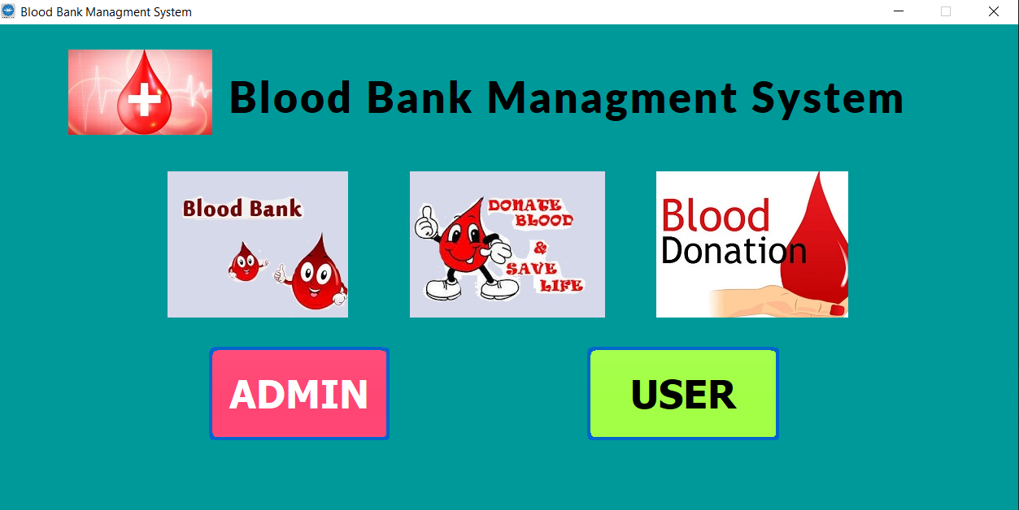
Output : Home Page

Slide 14
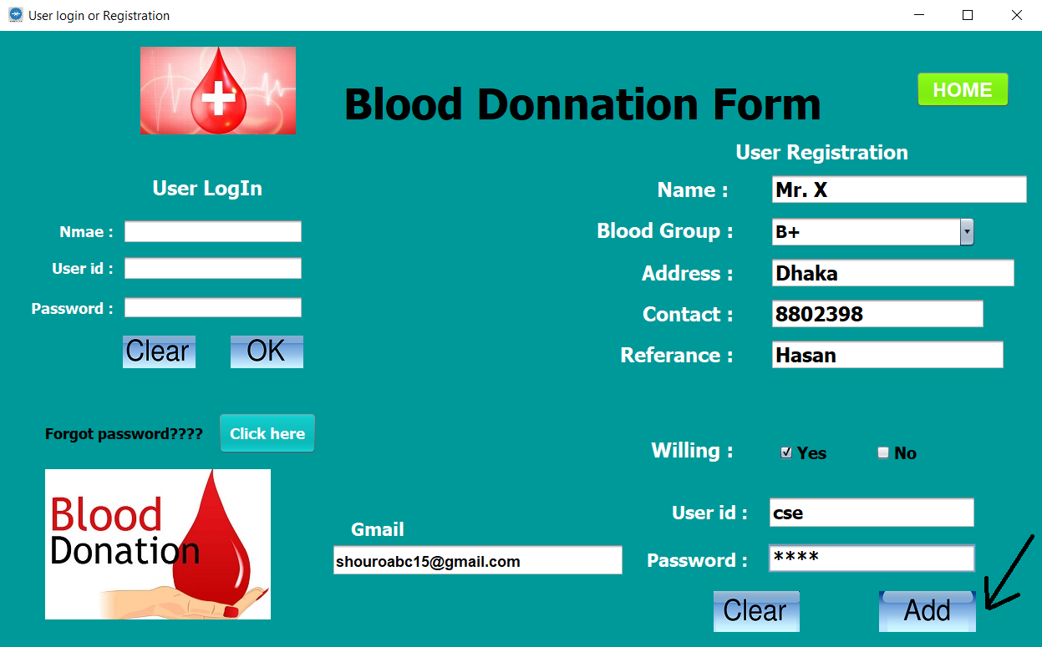
Fill up Registration from

Slide 15
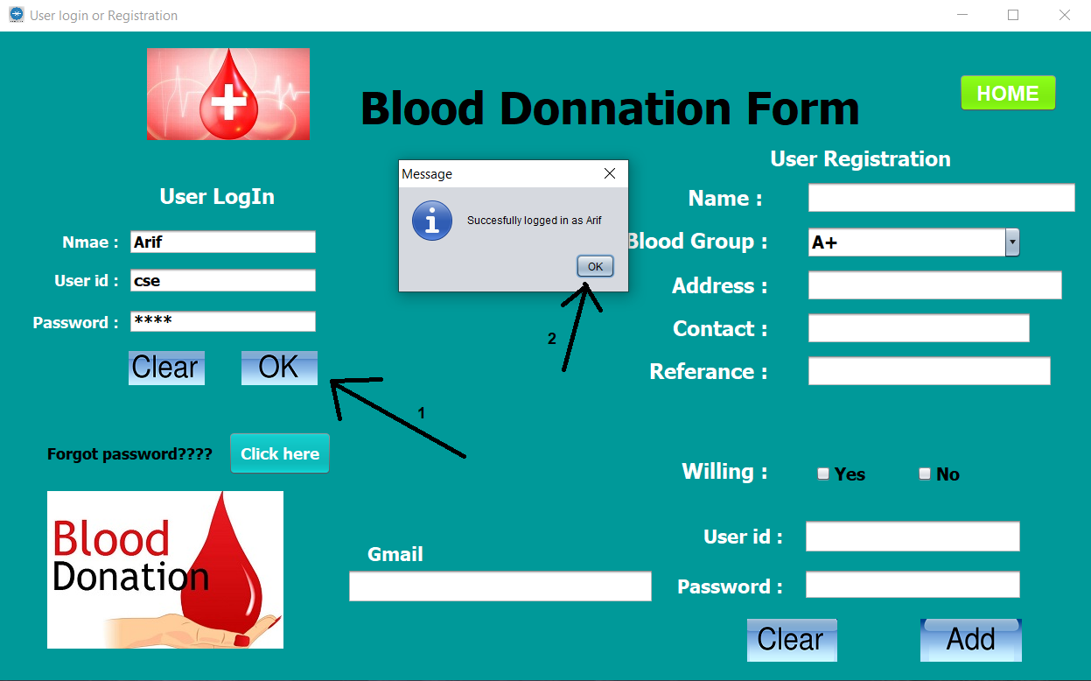
Login to user a Account

Slide 16
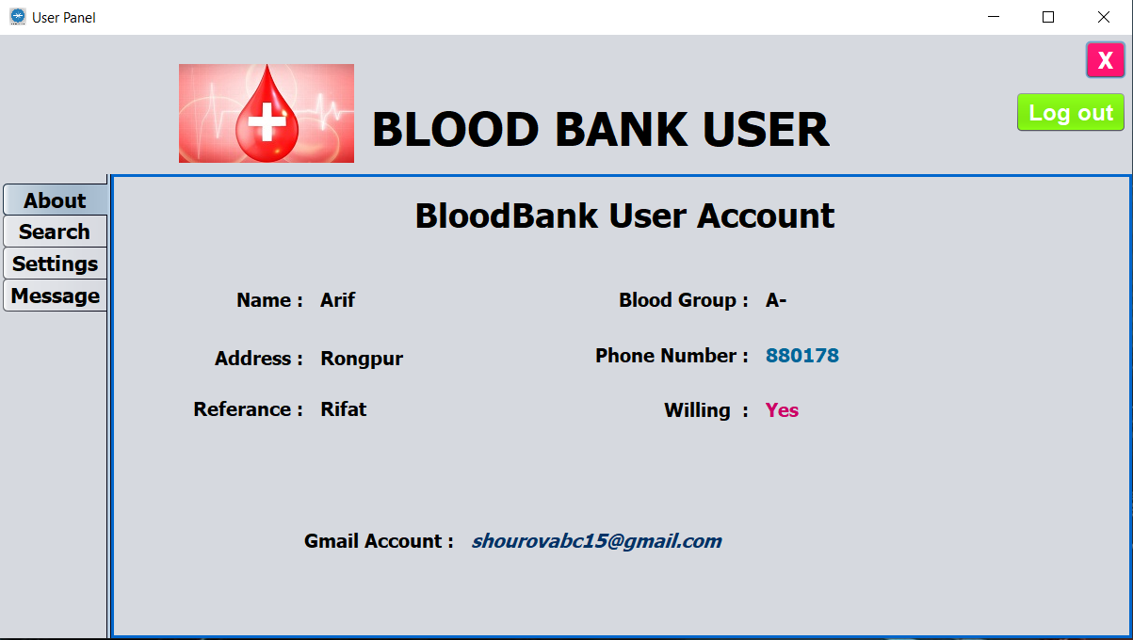
User Account : About panel

Slide 17
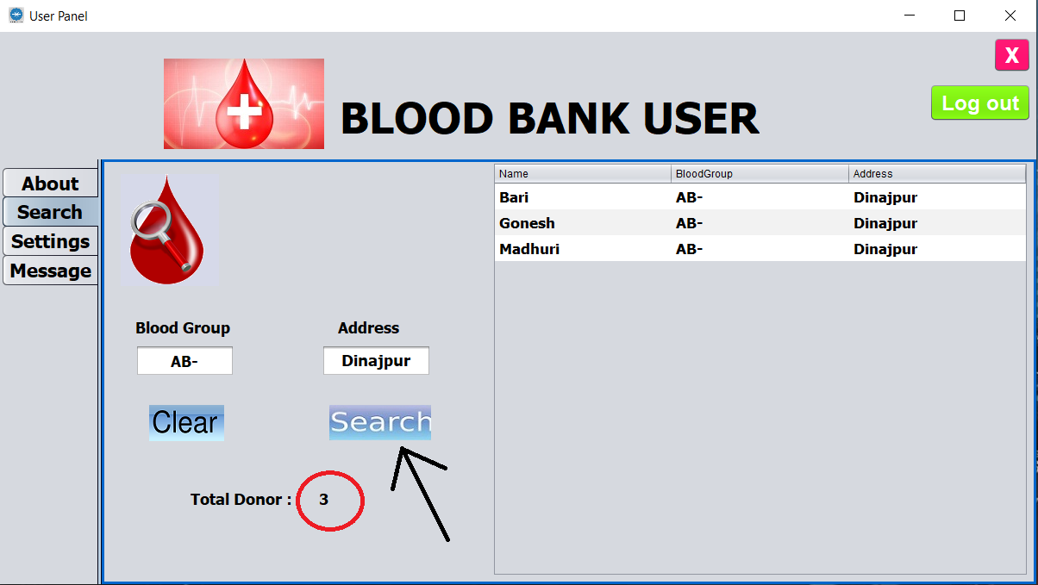
Search blood Donor

Slide 18
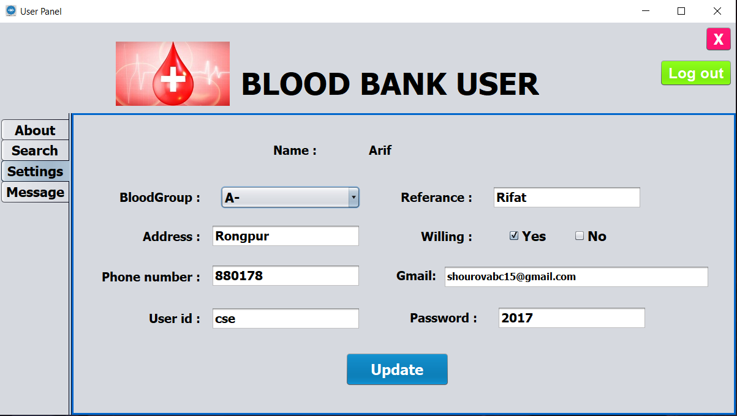
Update personal information

Slide 19
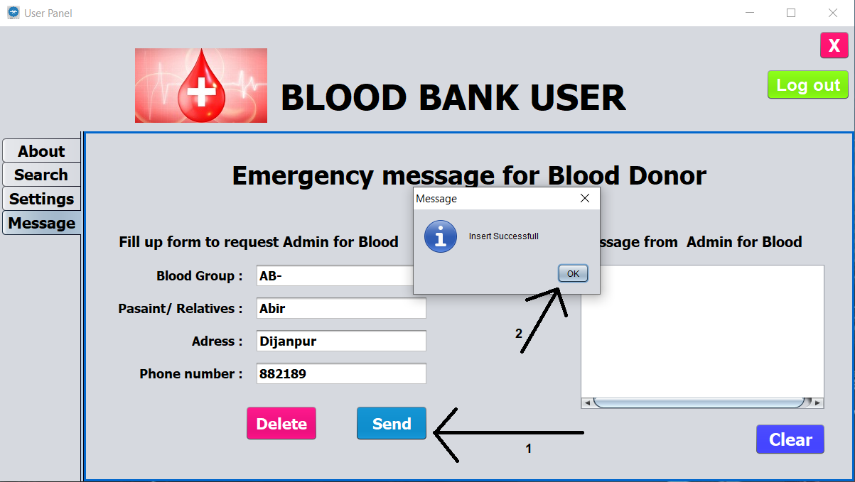
Send Message to Admin

Slide 20
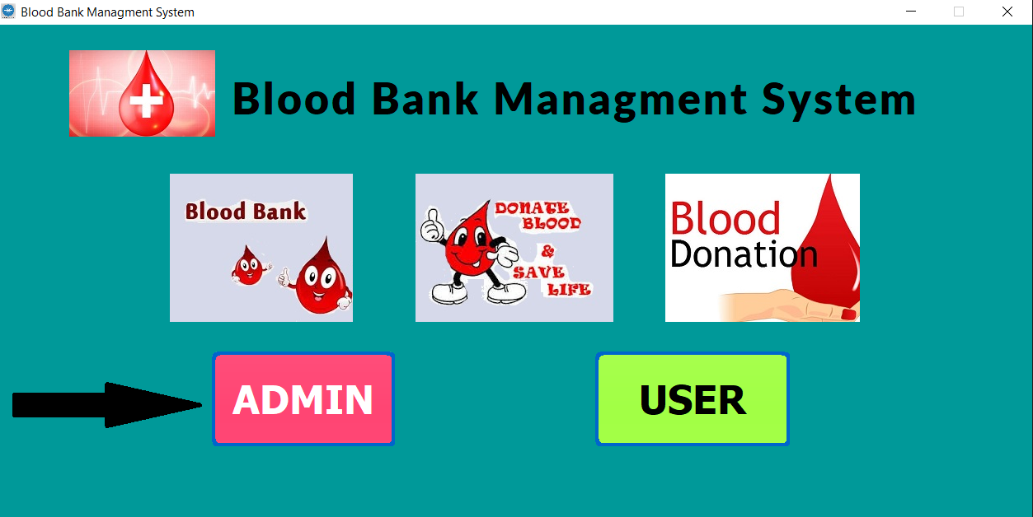
Go to Admin Login form

Slide 21
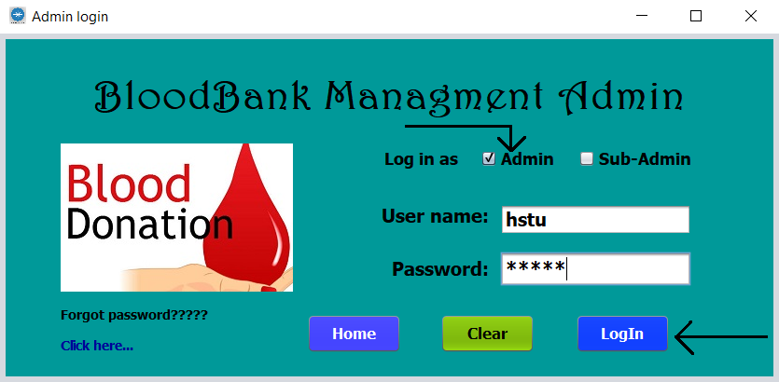
Login as Admin

Slide 22
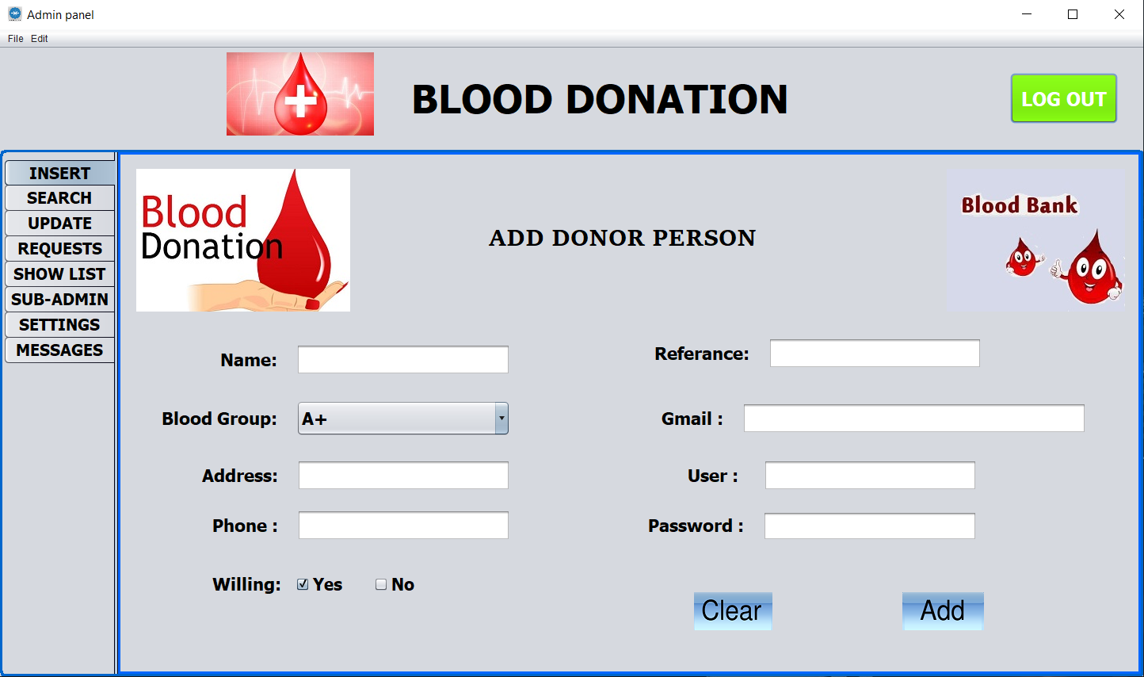
Admin Control Panel - Add Donor

Slide 23
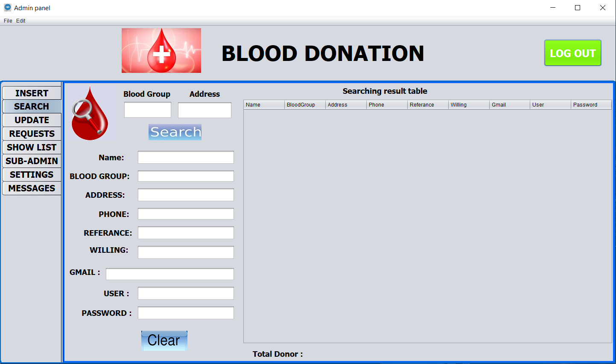
Search Blood Donor

Slide 24
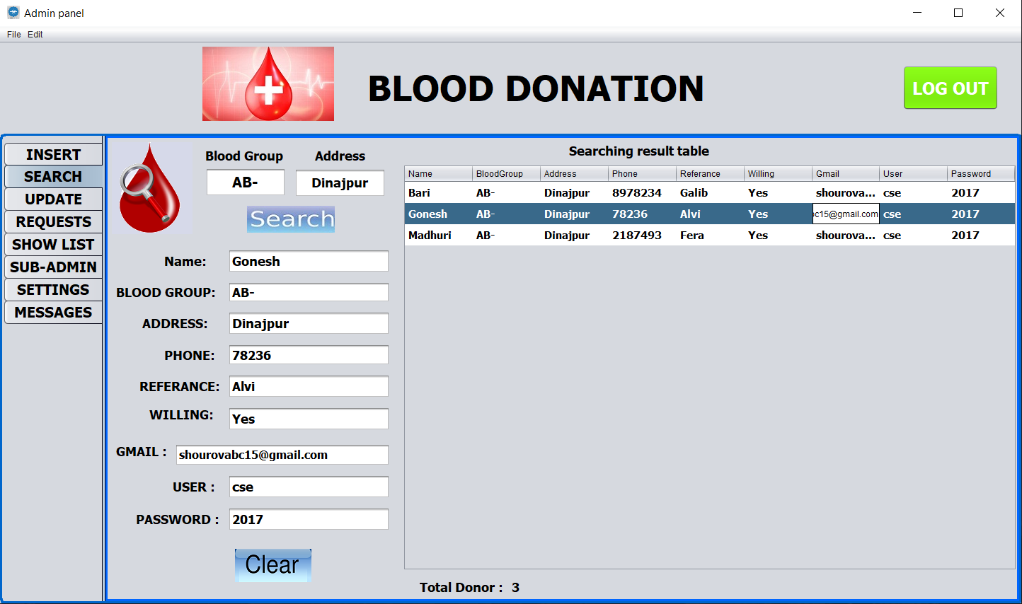
Show Search Result

Slide 25
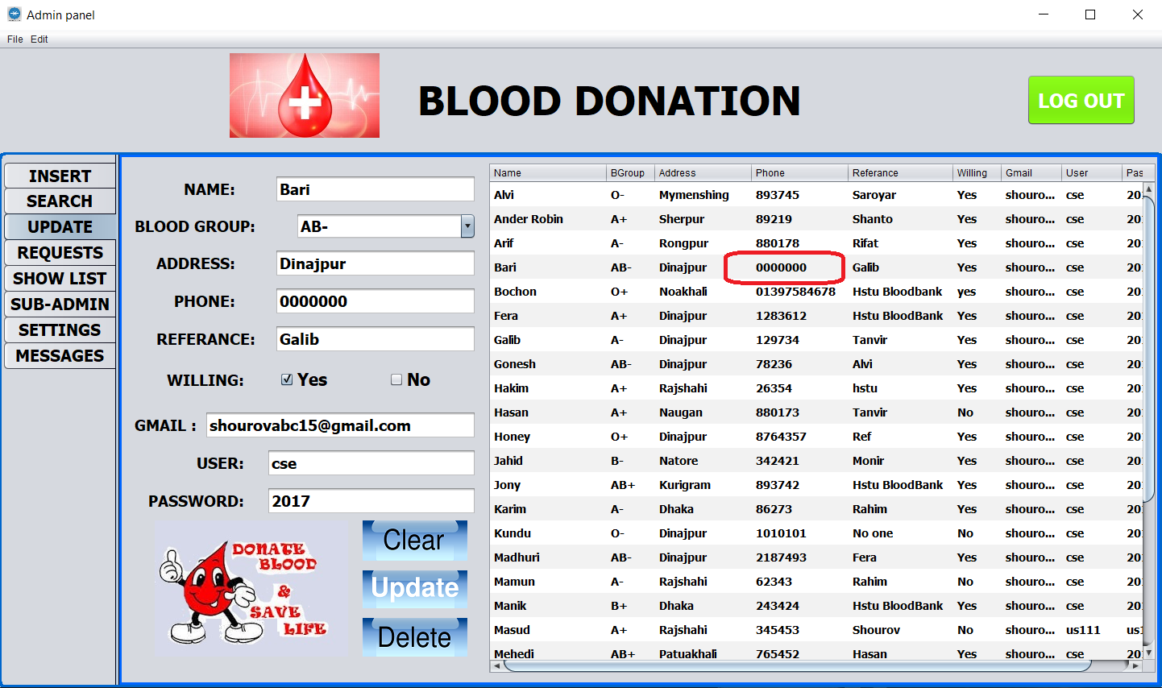
Update User Information

Slide 26
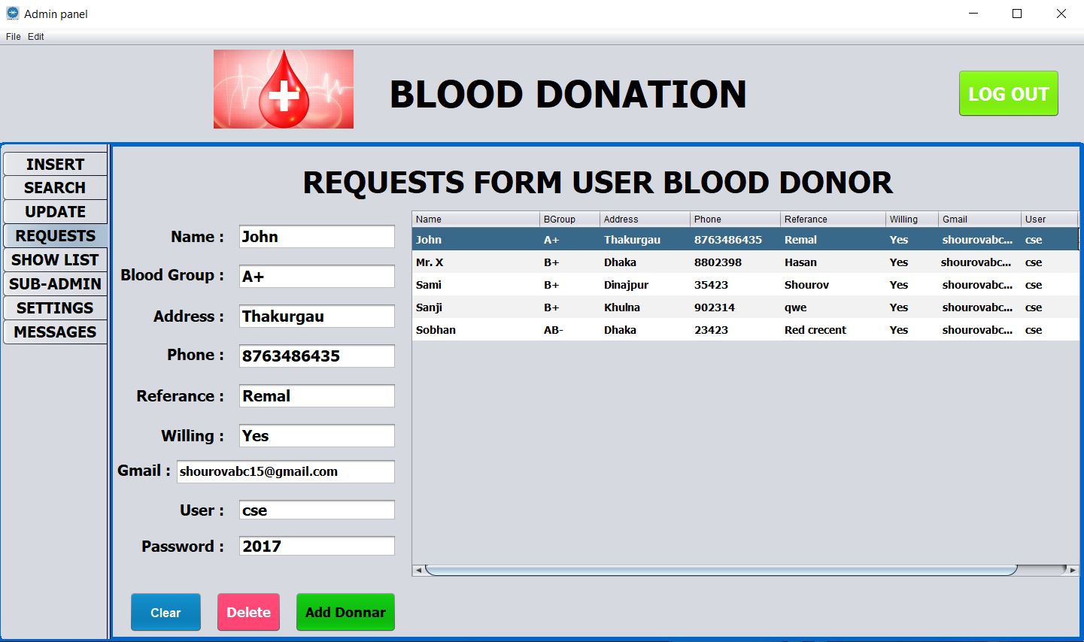
User Request

Slide 27
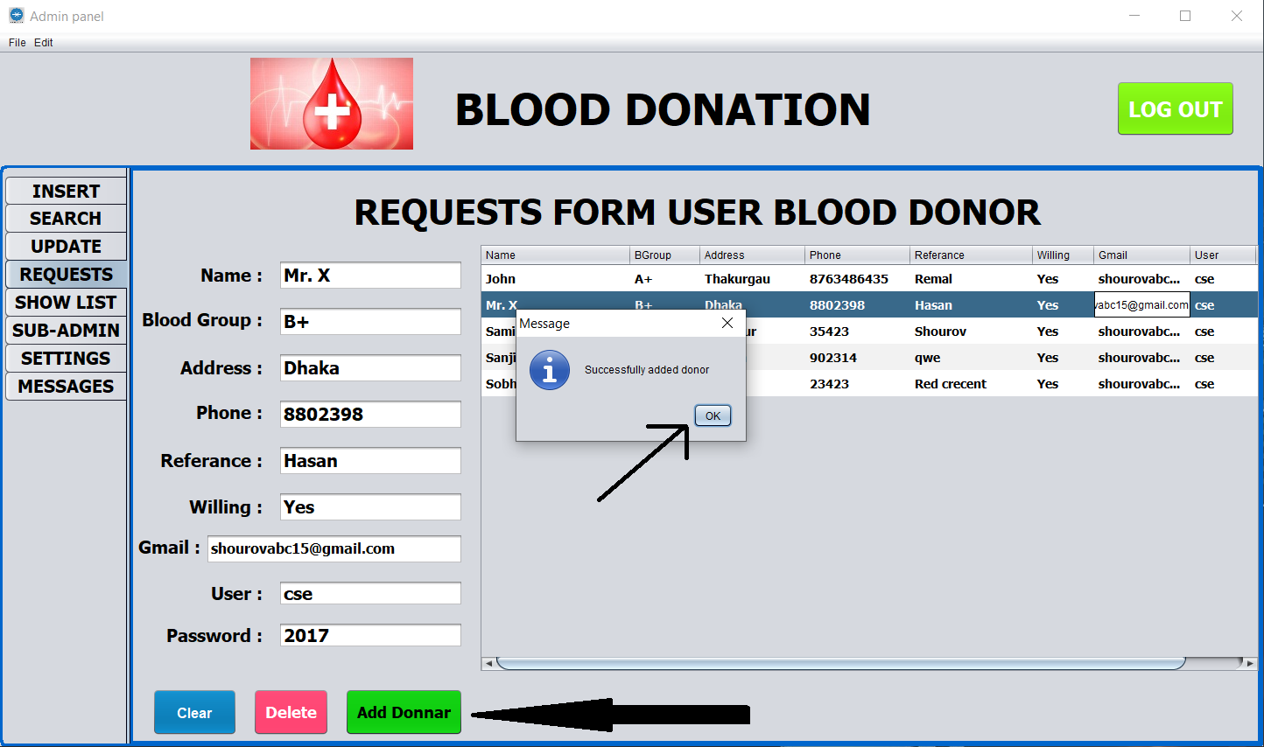
Select user and add as donor

Slide 28
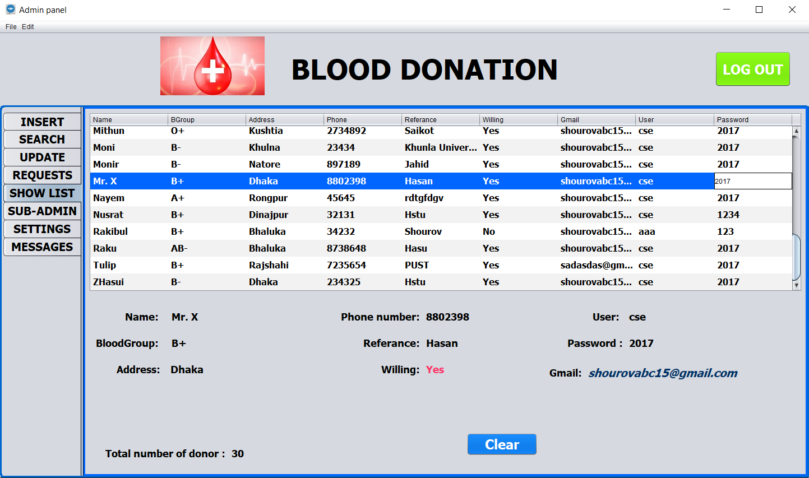
Show Full Donor List

Slide 29
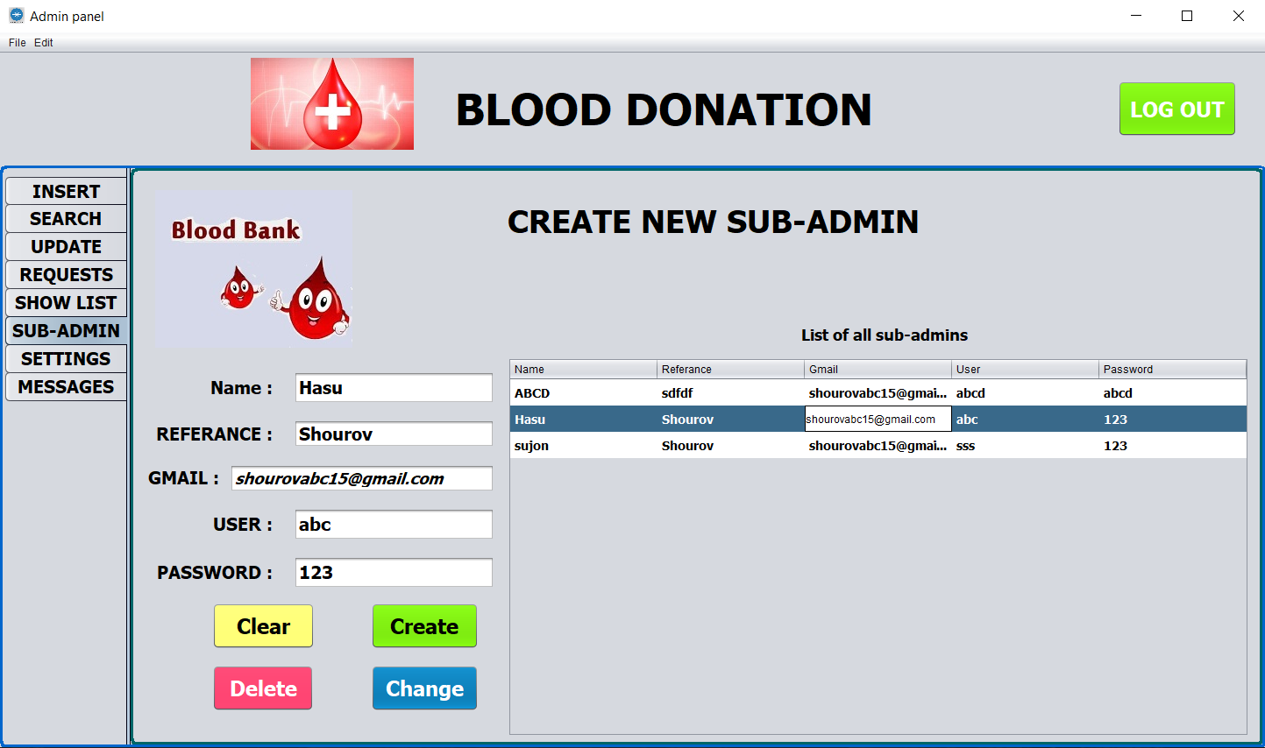
Customize Sub-admin

Slide 30
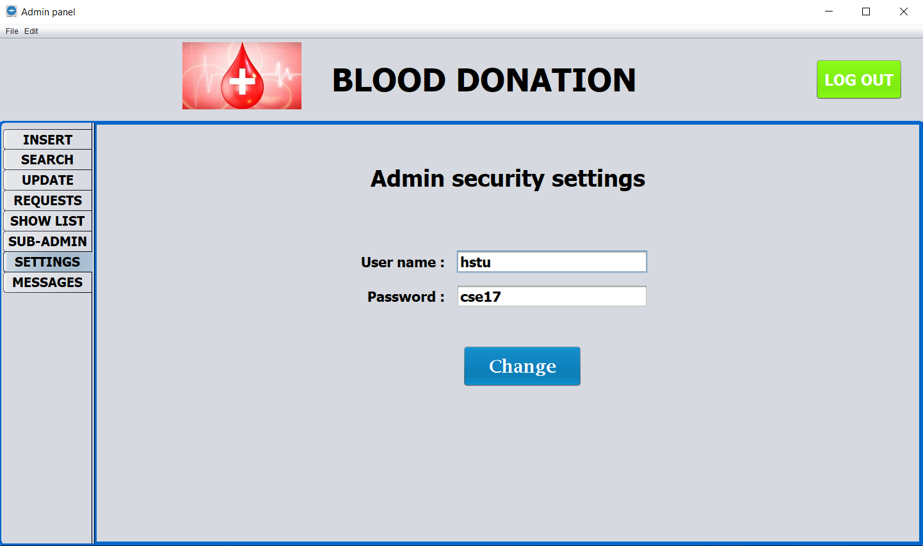
Settings

Slide 31
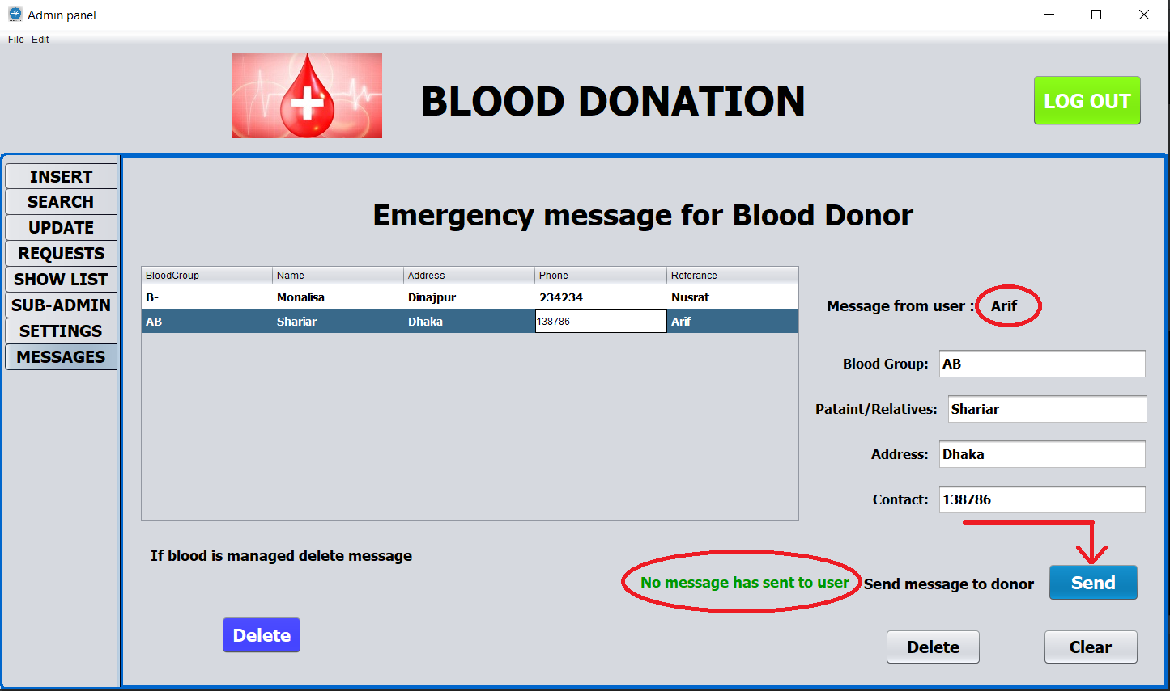
Message from user

Slide 32
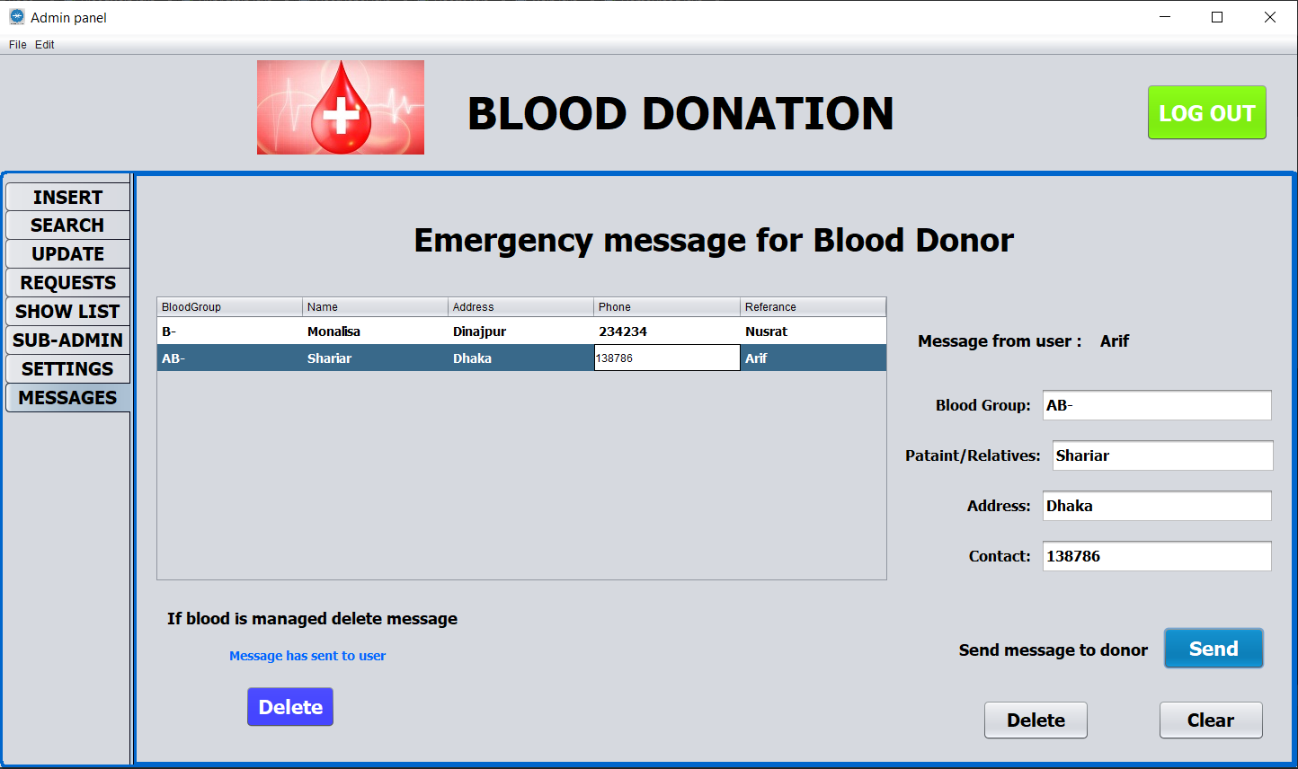
After sending message to donor

Slide 33
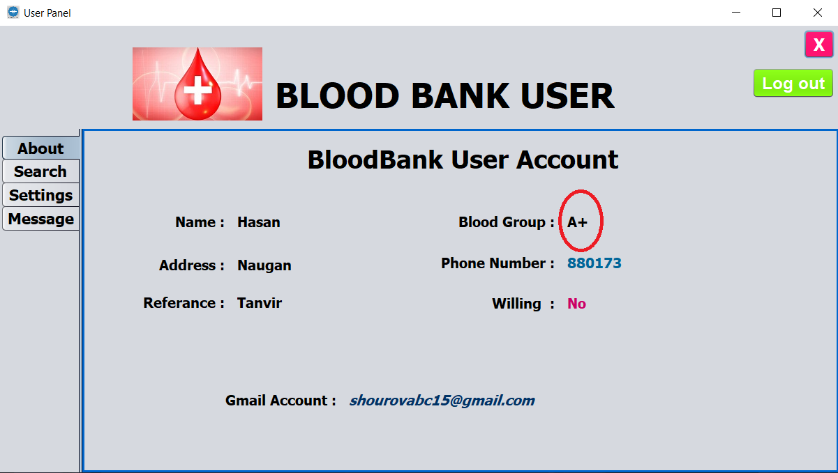
Output of the project:

Slide 34
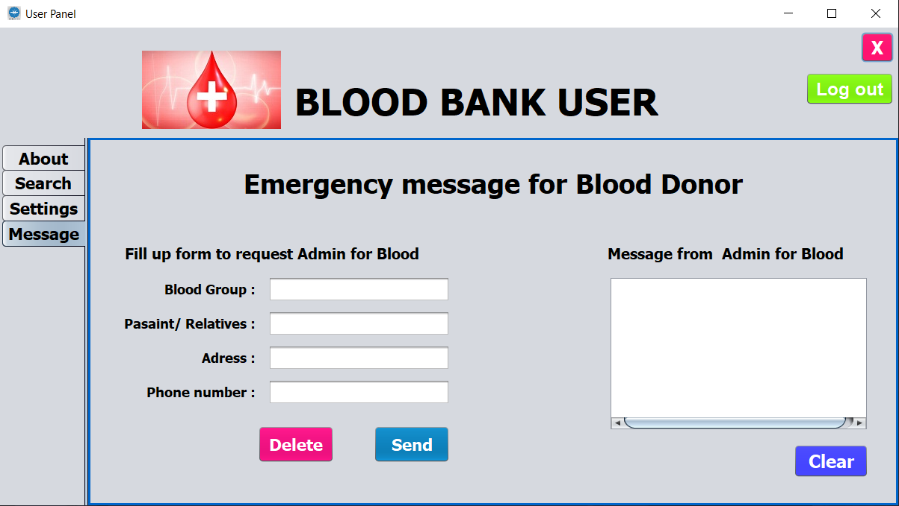
Output of the project:

Slide 35
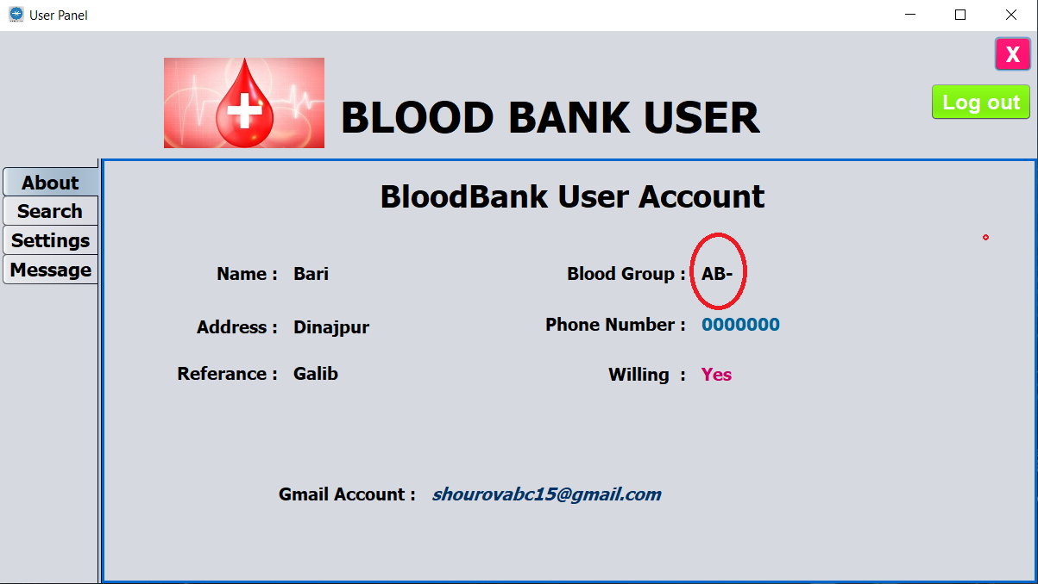
Output of the project:

Slide 36
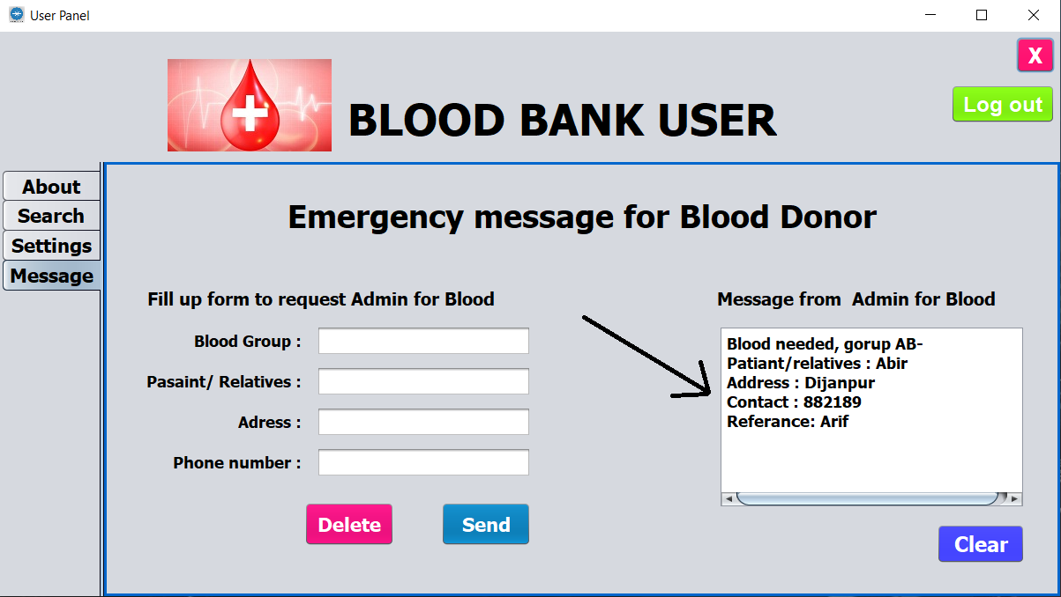
Output of the project:

Slide 37
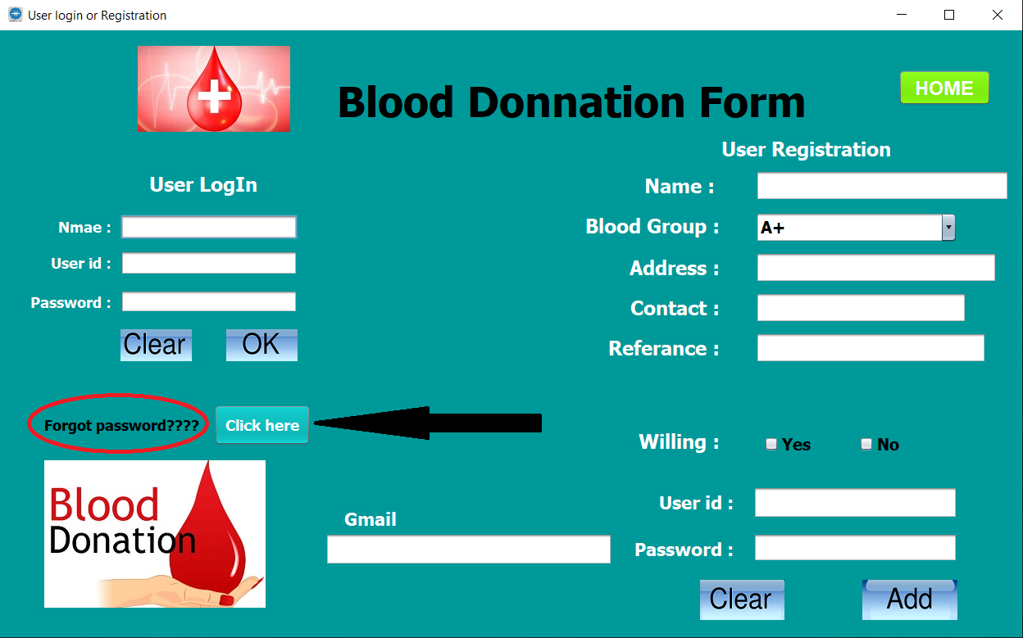
Output of the project:

Slide 38
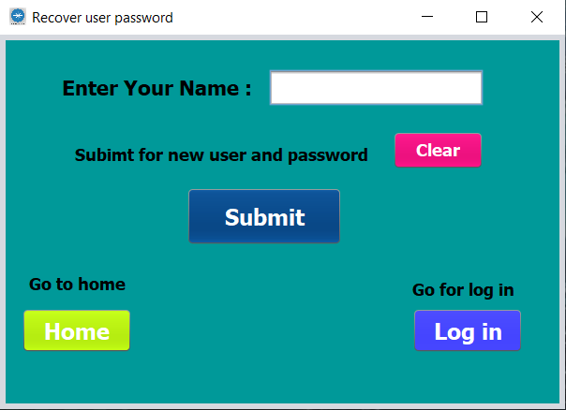
Output of the project:

Slide 39
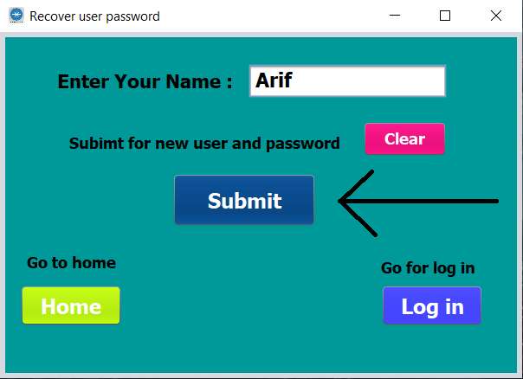
Output of the project:

Slide 40
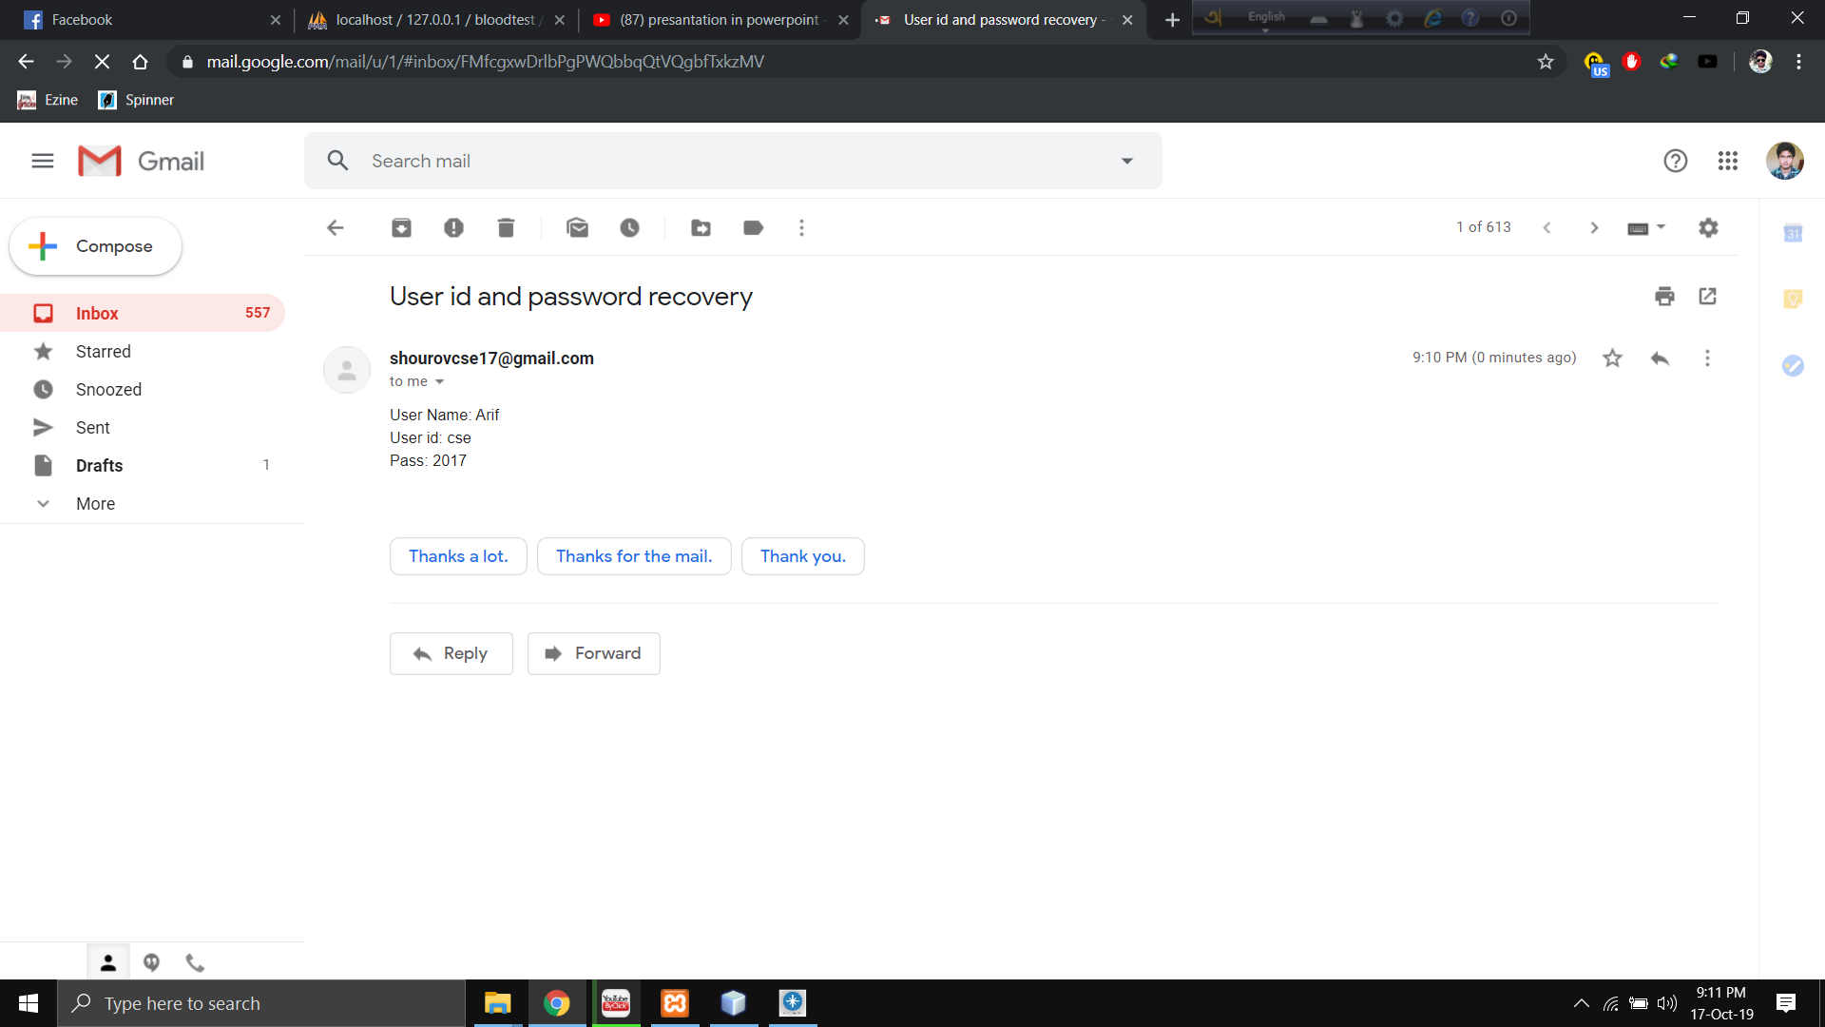
Output of the project:

Slide 41
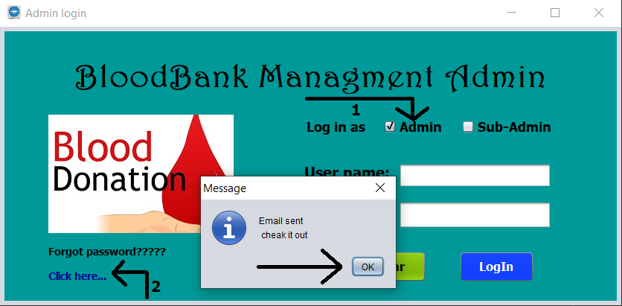
Output of the project:

Slide 42
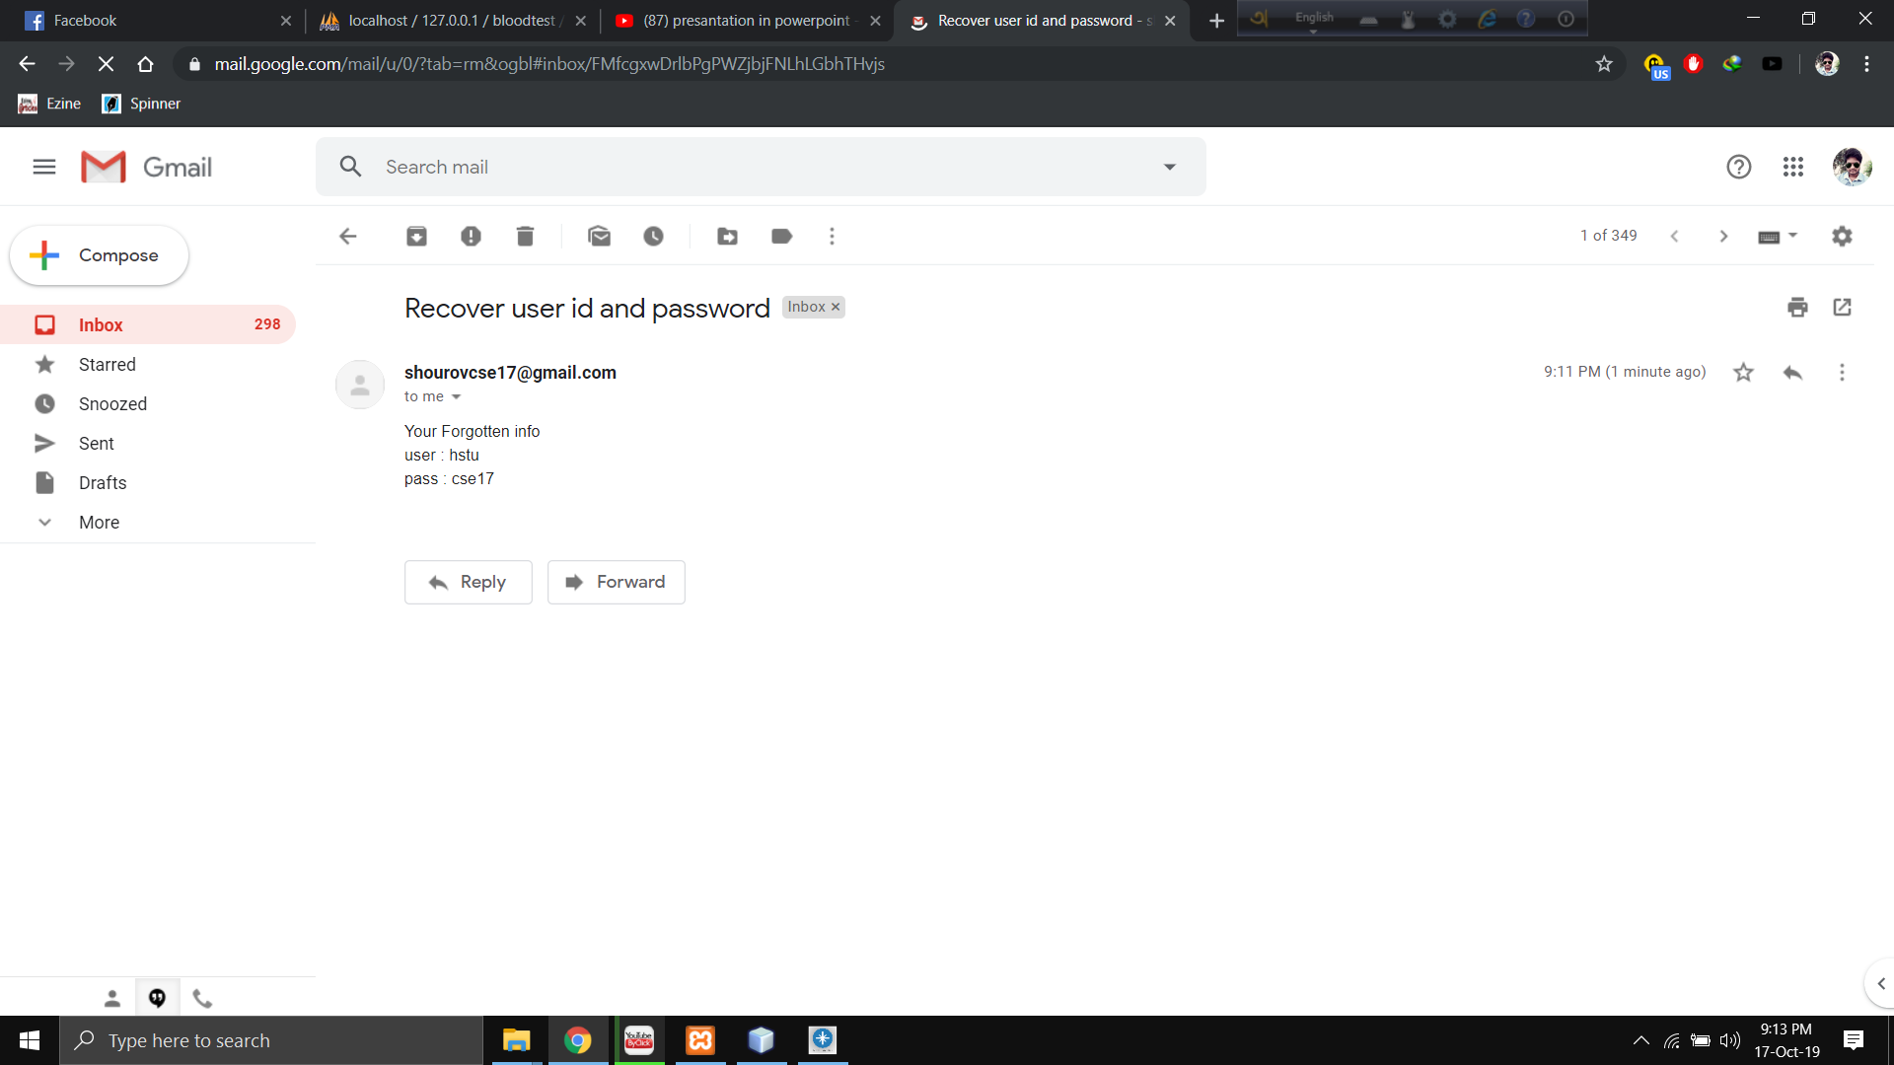
Output of the project:

Slide 43
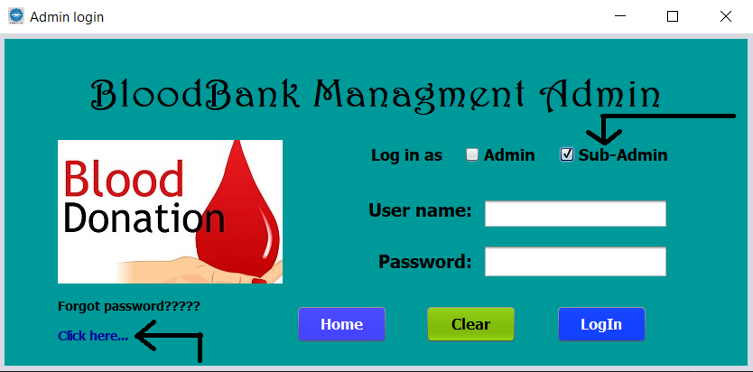
Output of the project:

Slide 44
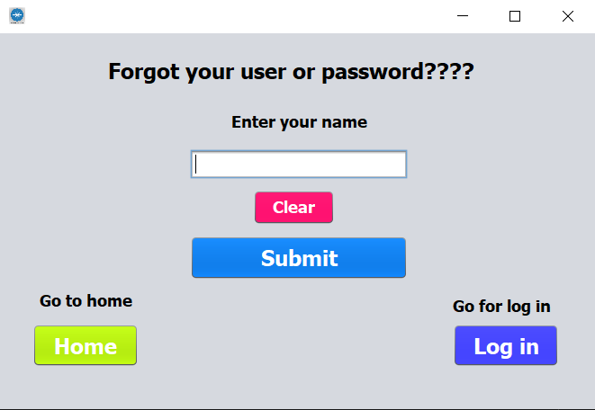
Output of the project:

Slide 45
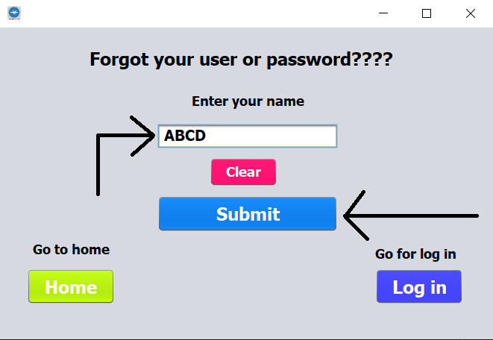
Output of the project:

Slide 46

Output of the project:

Slide 47
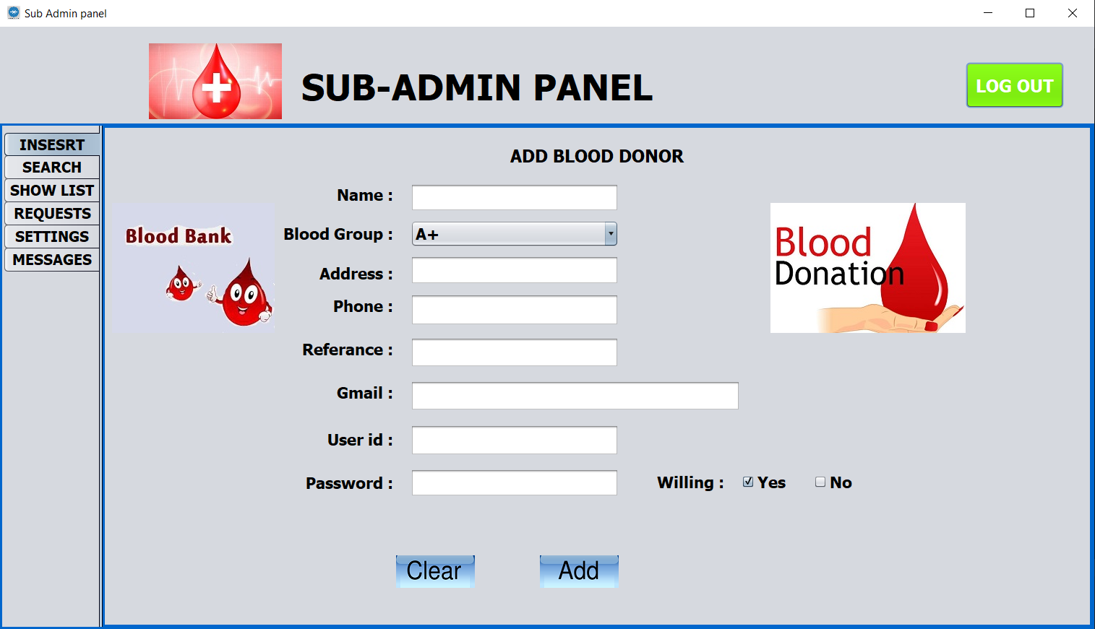
Output of the project:

Slide 48
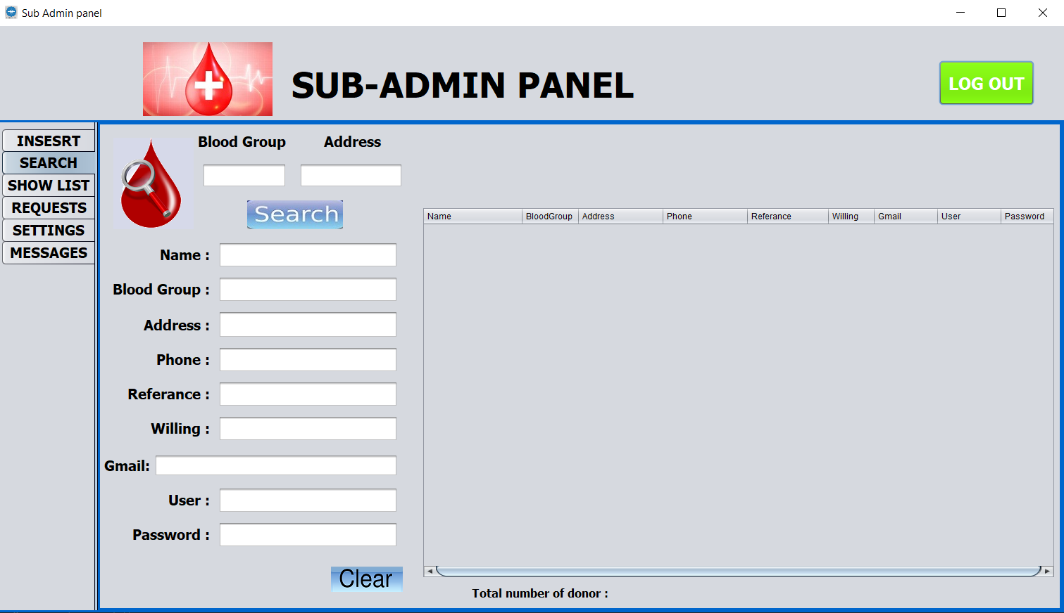
Output of the project:

Slide 49
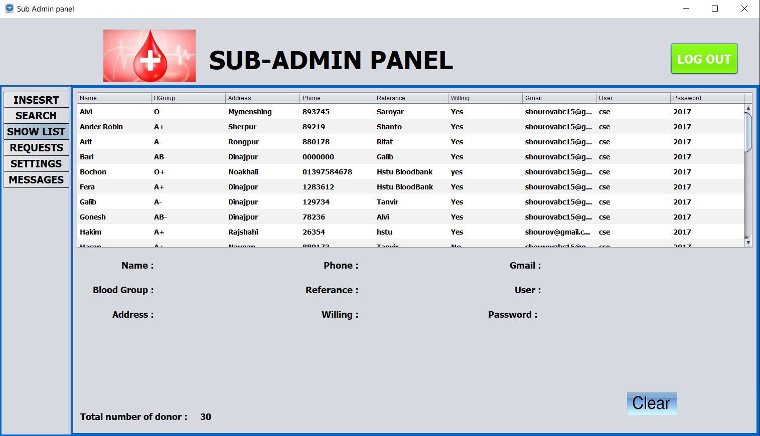
Output of the project:

Slide 50
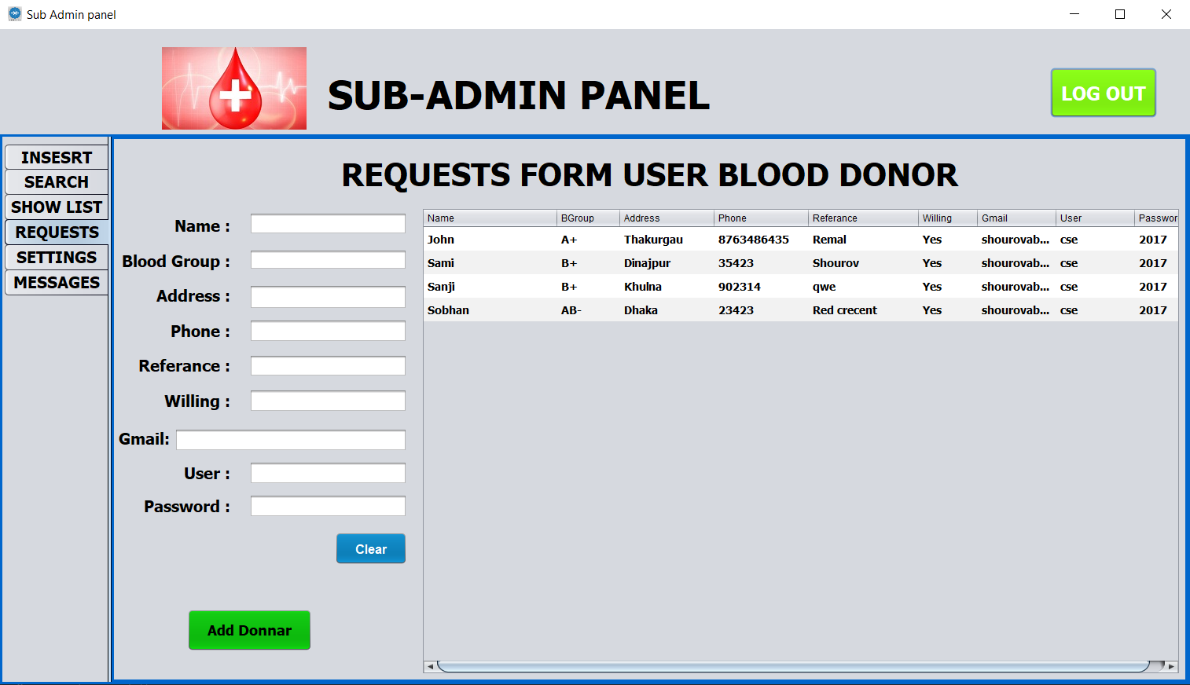
Output of the project:

Slide 51
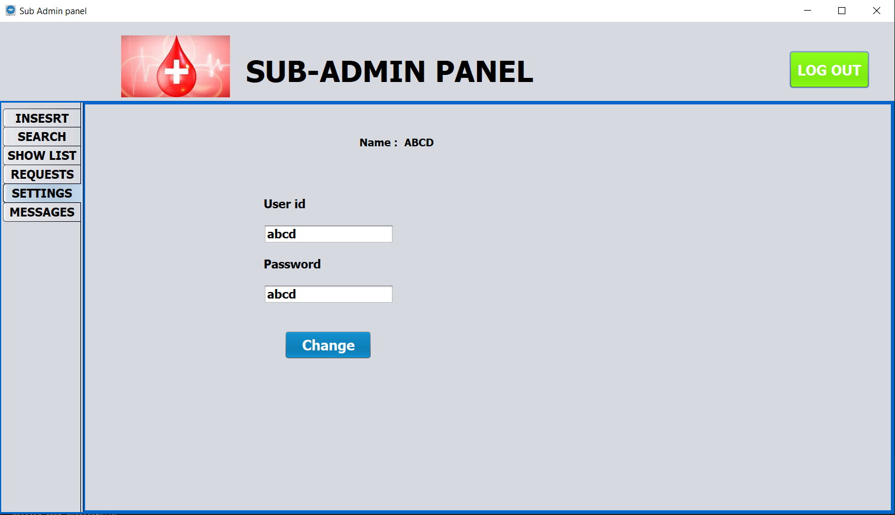
Output of the project

Slide 52
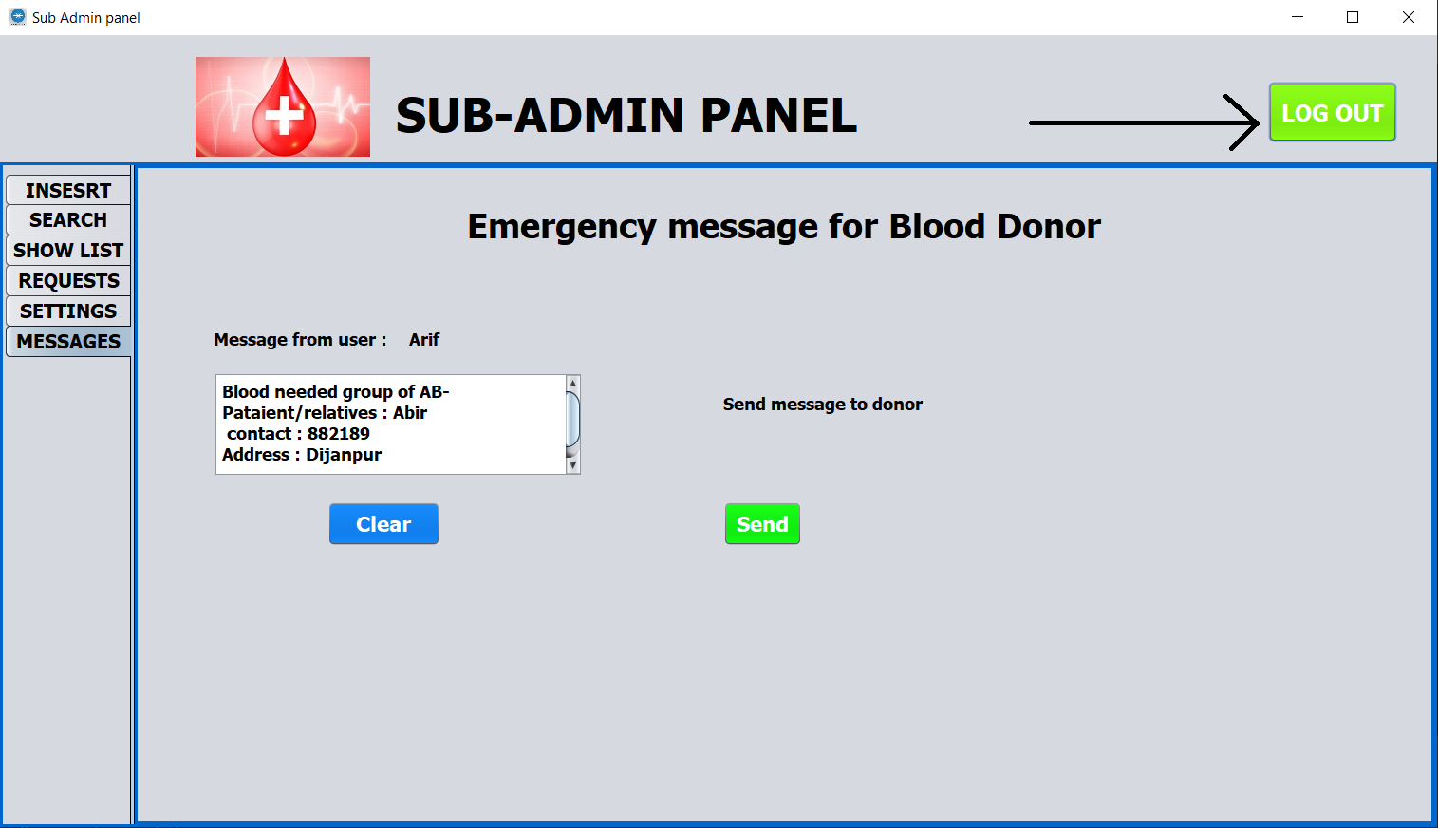
Output of the project

Slide 53
Advantages
Very easy to user and supported to any desktop or laptop device.
Admin, sub-admin, user every one can use same application in separate device.
Anyone can search donor by blood group or address or both of them.
Half-duplex communication system between admin and user.
Organization won’t stop in absence of admin, hence having sub-admin.
Sub-admin and user can update their own information.
Everyone can recover user id and password by mail.

Slide 54
Limitation
Our project can store 50 million records of blood donor
It can’t provide full duplex communication
User can’t be a donor directly
User can’t see all information about any donor

Slide 55
Summary
As we are using offline database user can’t use the application from any other device. In future we will use the online database to make the application useable for everyone. We will also try to provide a better communication than now.

Slide 56
Thank You

